Slide 1
Neuroscience
Randall C. O’Reilly

Slide 2
Emergence The soul in the machine..
(Now Imagine 10,000,000,000 gears, each interacting with 10,000 others..)

Slide 3
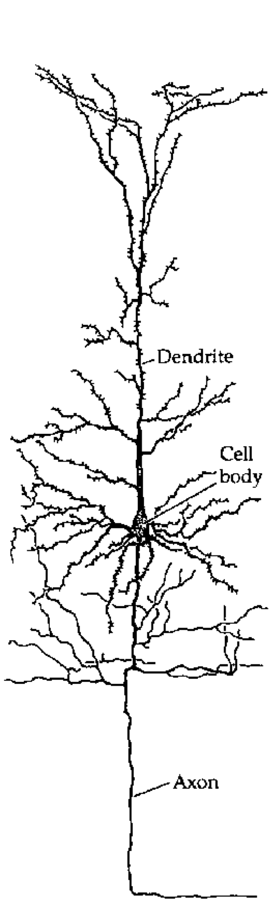
The Basic Unit of Cognition!?

Slide 4
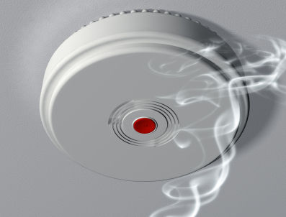
Neurons are Detectors

Slide 5
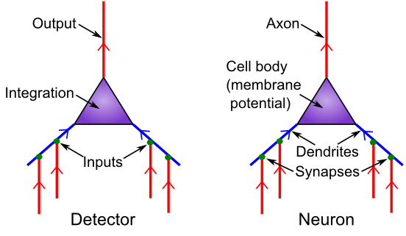
Detector Model
Is it really all just detection?

Slide 6
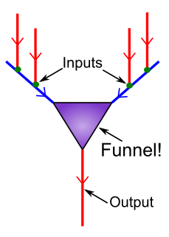
Neurons Compress 10,000 -> 1

Slide 7
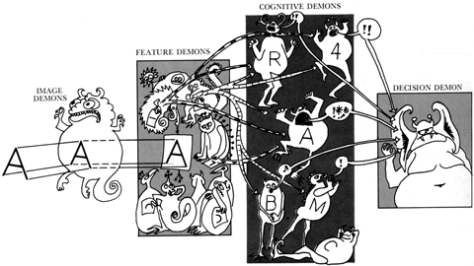
Pandemonium! (Oliver Selfridge)

Slide 8
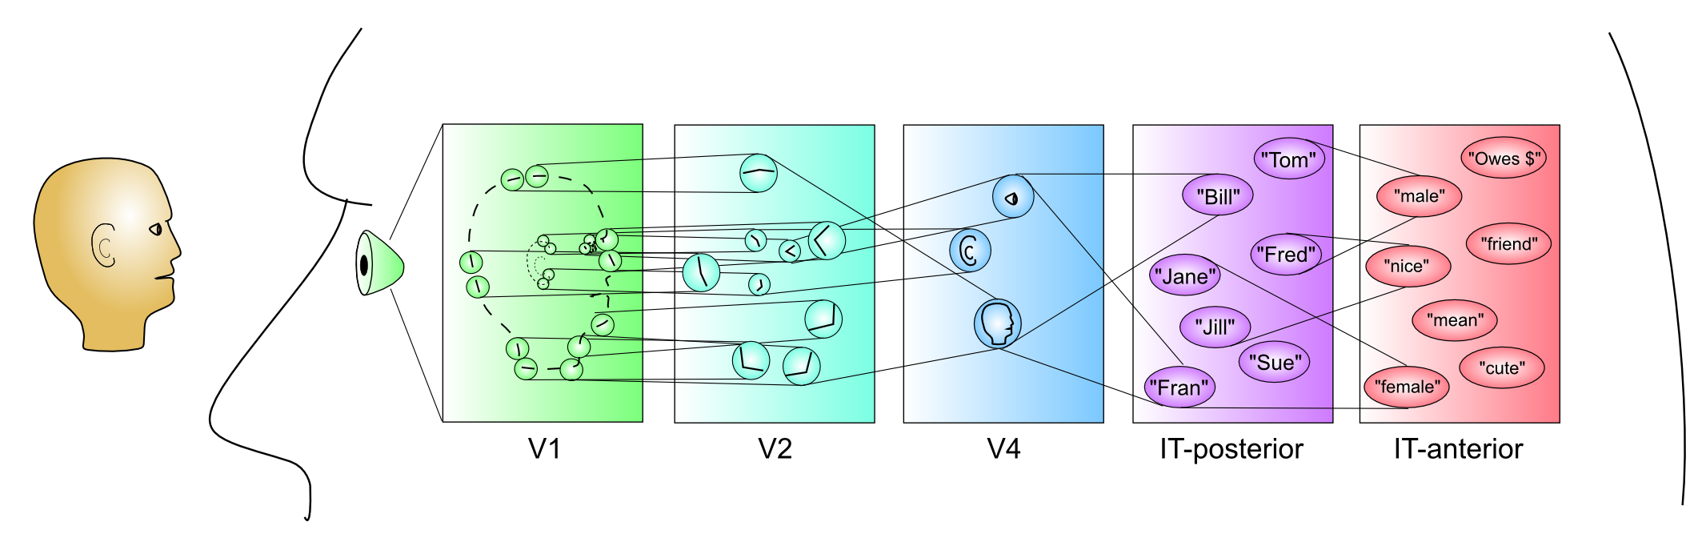
Hierarchy of Detectors (Compression: abstract, simplify)
Inferior Temporal (IT) cortex has high-level abstractions that are relevant to your life!
It takes a village of neurons to build up these abstractions.

Slide 9
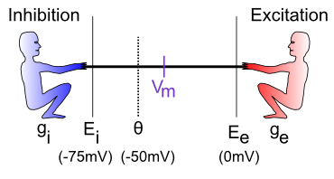
The Tug-of-War
How strongly each guy pulls: I = g (E-Vm) = current
g = how many input channels are open
E = driving potential (pull down for inhibition, up for excitation)
Vm = the “flag” – reflects net balance between two sides

Slide 10
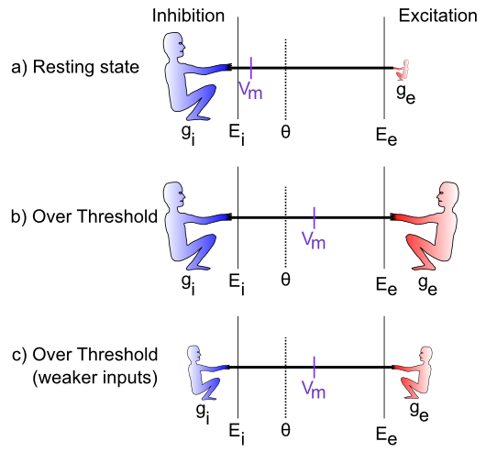
The Tug-of-War (Contrast: Excitation relative to Inhibition)

Slide 11
Equations (just for fun)!

Slide 12
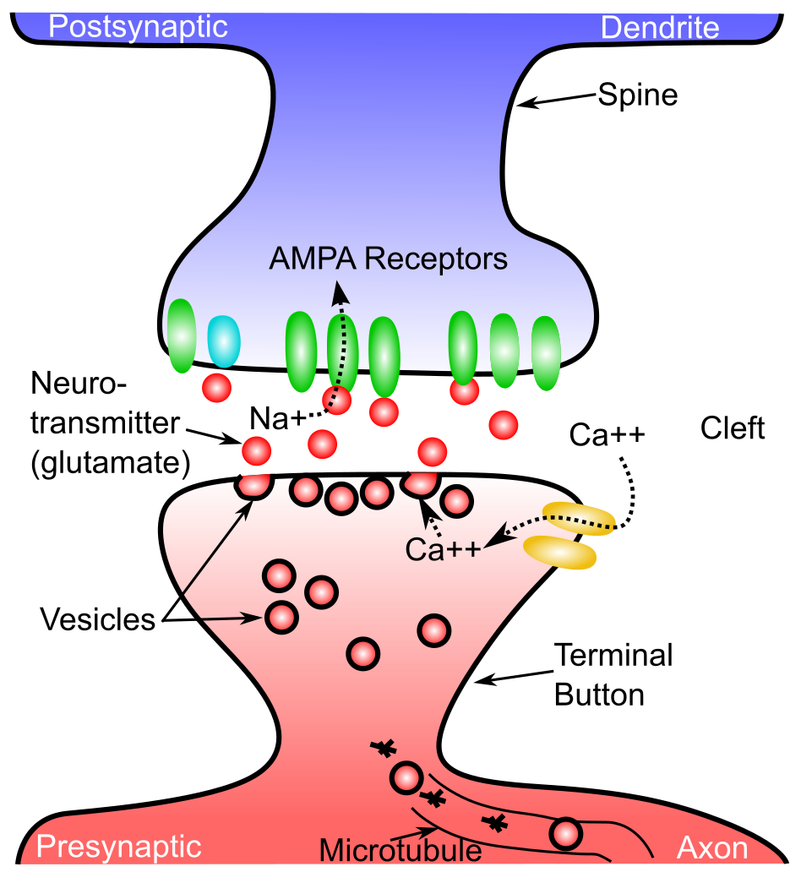
The Synapse

Slide 13
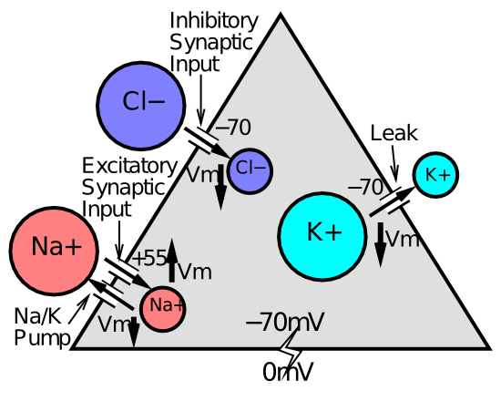
The Full Story..

Slide 14
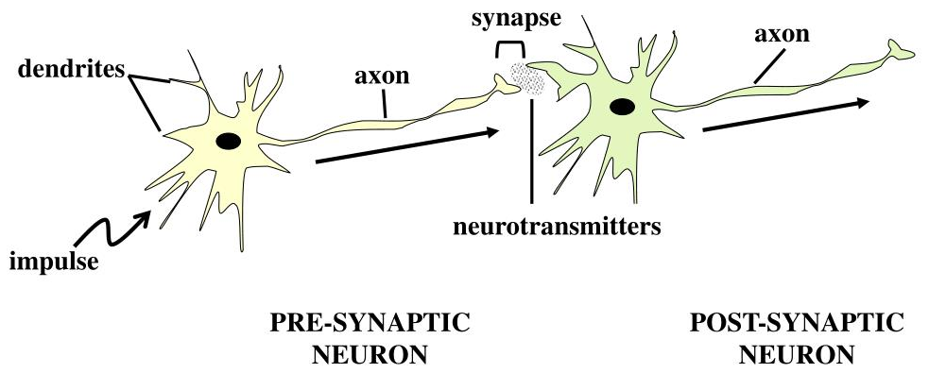
Neuron Summary
Neurons integrate electrical signals (depolarization) received via synapses on their dendrites, from axons of other neurons
When membrane potential exceeds threshold, action potential (spike) is sent down axon, triggering release of neurotransmitter in synapse, which opens ion channels on receiving (postsynaptic) neuron (goto start)
GABA = inhibitory, Cl-, Glutamate = excitatory, Na+
In Neocortex, a neuron either releases GABA or Glu, not both!

Slide 15
Neurotransmitter Terms
Agonist: acts like a given neurotransmitter
Antagonist: blocks receptors for given NT
Reuptake: takes NT back out of synapse
Neuromodulator: a broadly-released neurotransmitter that has widespread modulatory effects on the brain

Slide 16
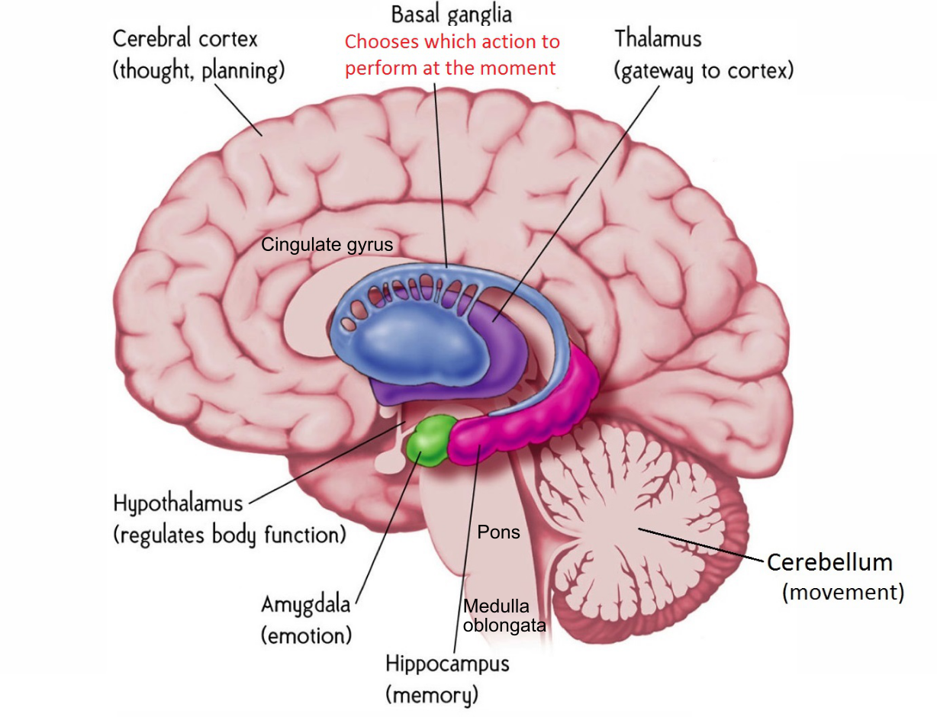
Gross Anatomy

Slide 17
We are Corticocentric..
Cerebral Cortex (Neocortex) is where most of the good stuff happens: cognition, intelligence, knowledge, memory, consciousness, …
Hippocampus (archicortex), Amygdala, Basal Ganglia, Thalamus all interact extensively with neocortex, form tightly integrated subsystems (Limbic system is not super useful construct).
Lots of more specialized brain areas in subcortex, but seriously, who cares.. ☺

Slide 18
Summary of Brain Area Functions
Neocortex: perception, thought, action.. Everything!
Thalamus: sensory relay, arousal, attention..
Basal ganglia: decision making, control, dopamine
Amygdala: emotion
Hippocampus: episodic memory
Cerebellum / pons: error-driven motor learning
Hypothalamus: core body functions (eating etc), stress, hormones
Medulla oblongata: more core functions (breathing)

Slide 19
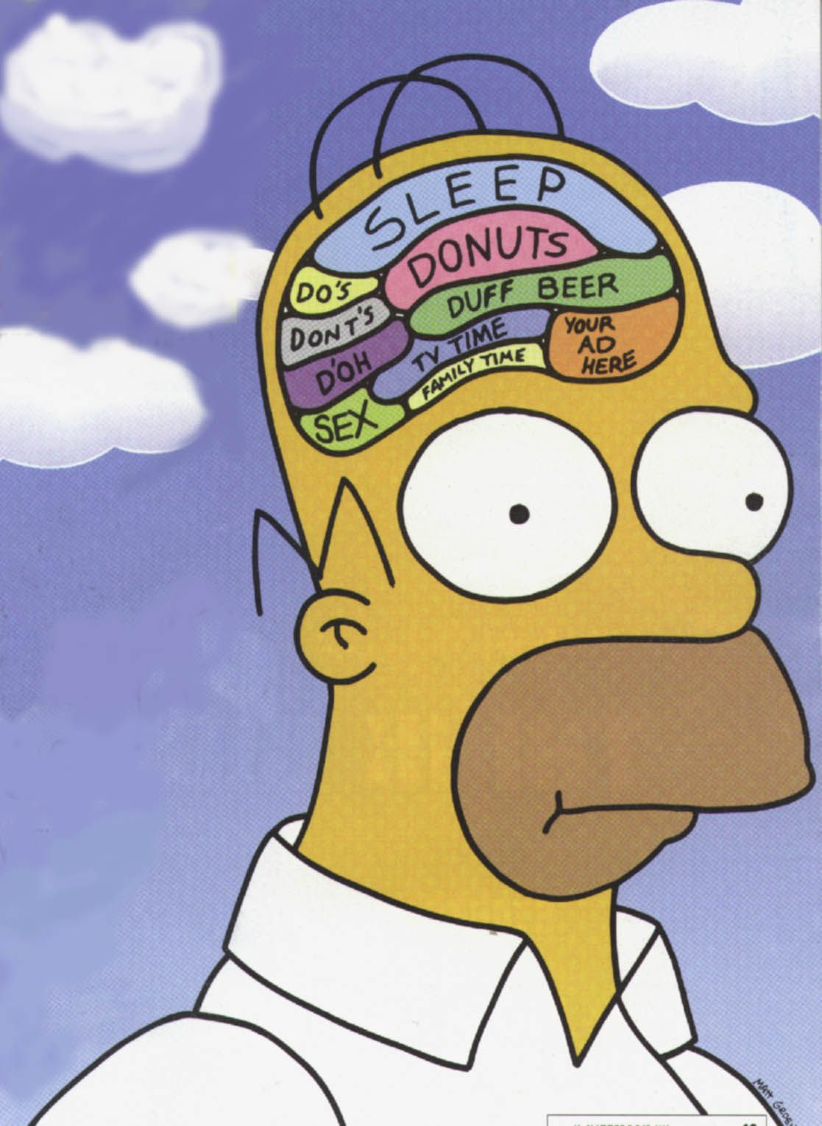
Functional Specialization

Slide 20
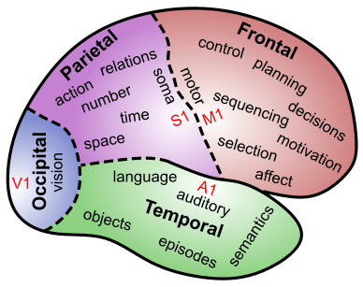
Lobular Functions: Follow the trail..

Slide 22
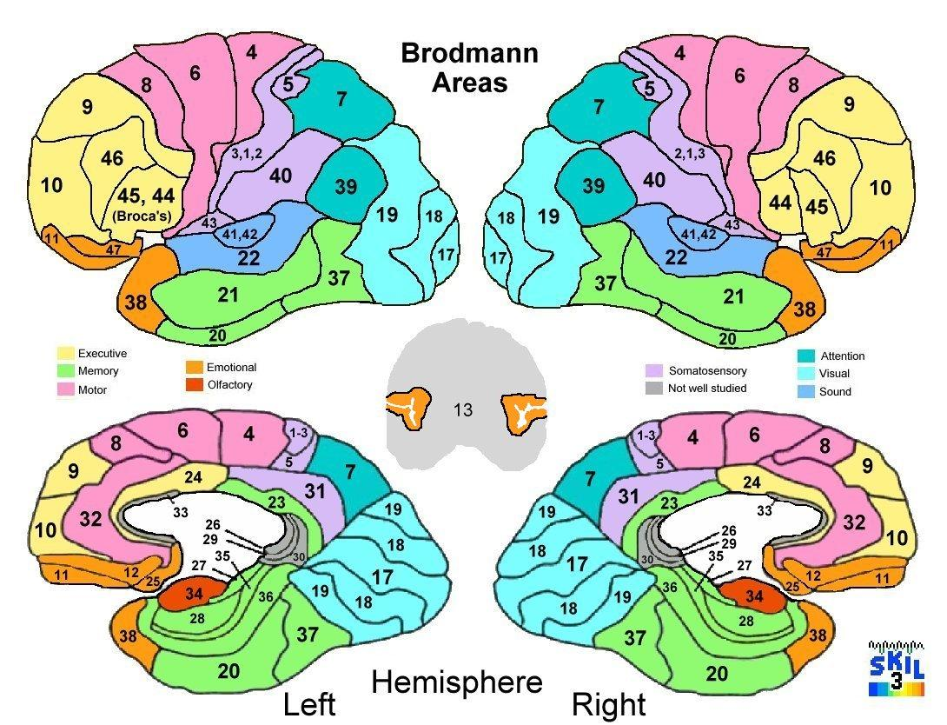

Slide 23
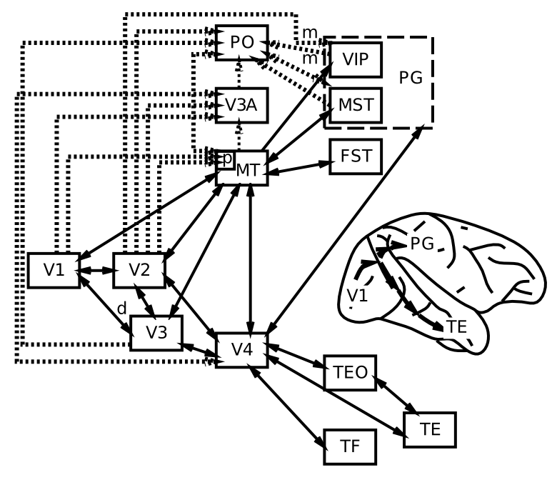
Visual Hierarchy: What vs Where

Slide 24
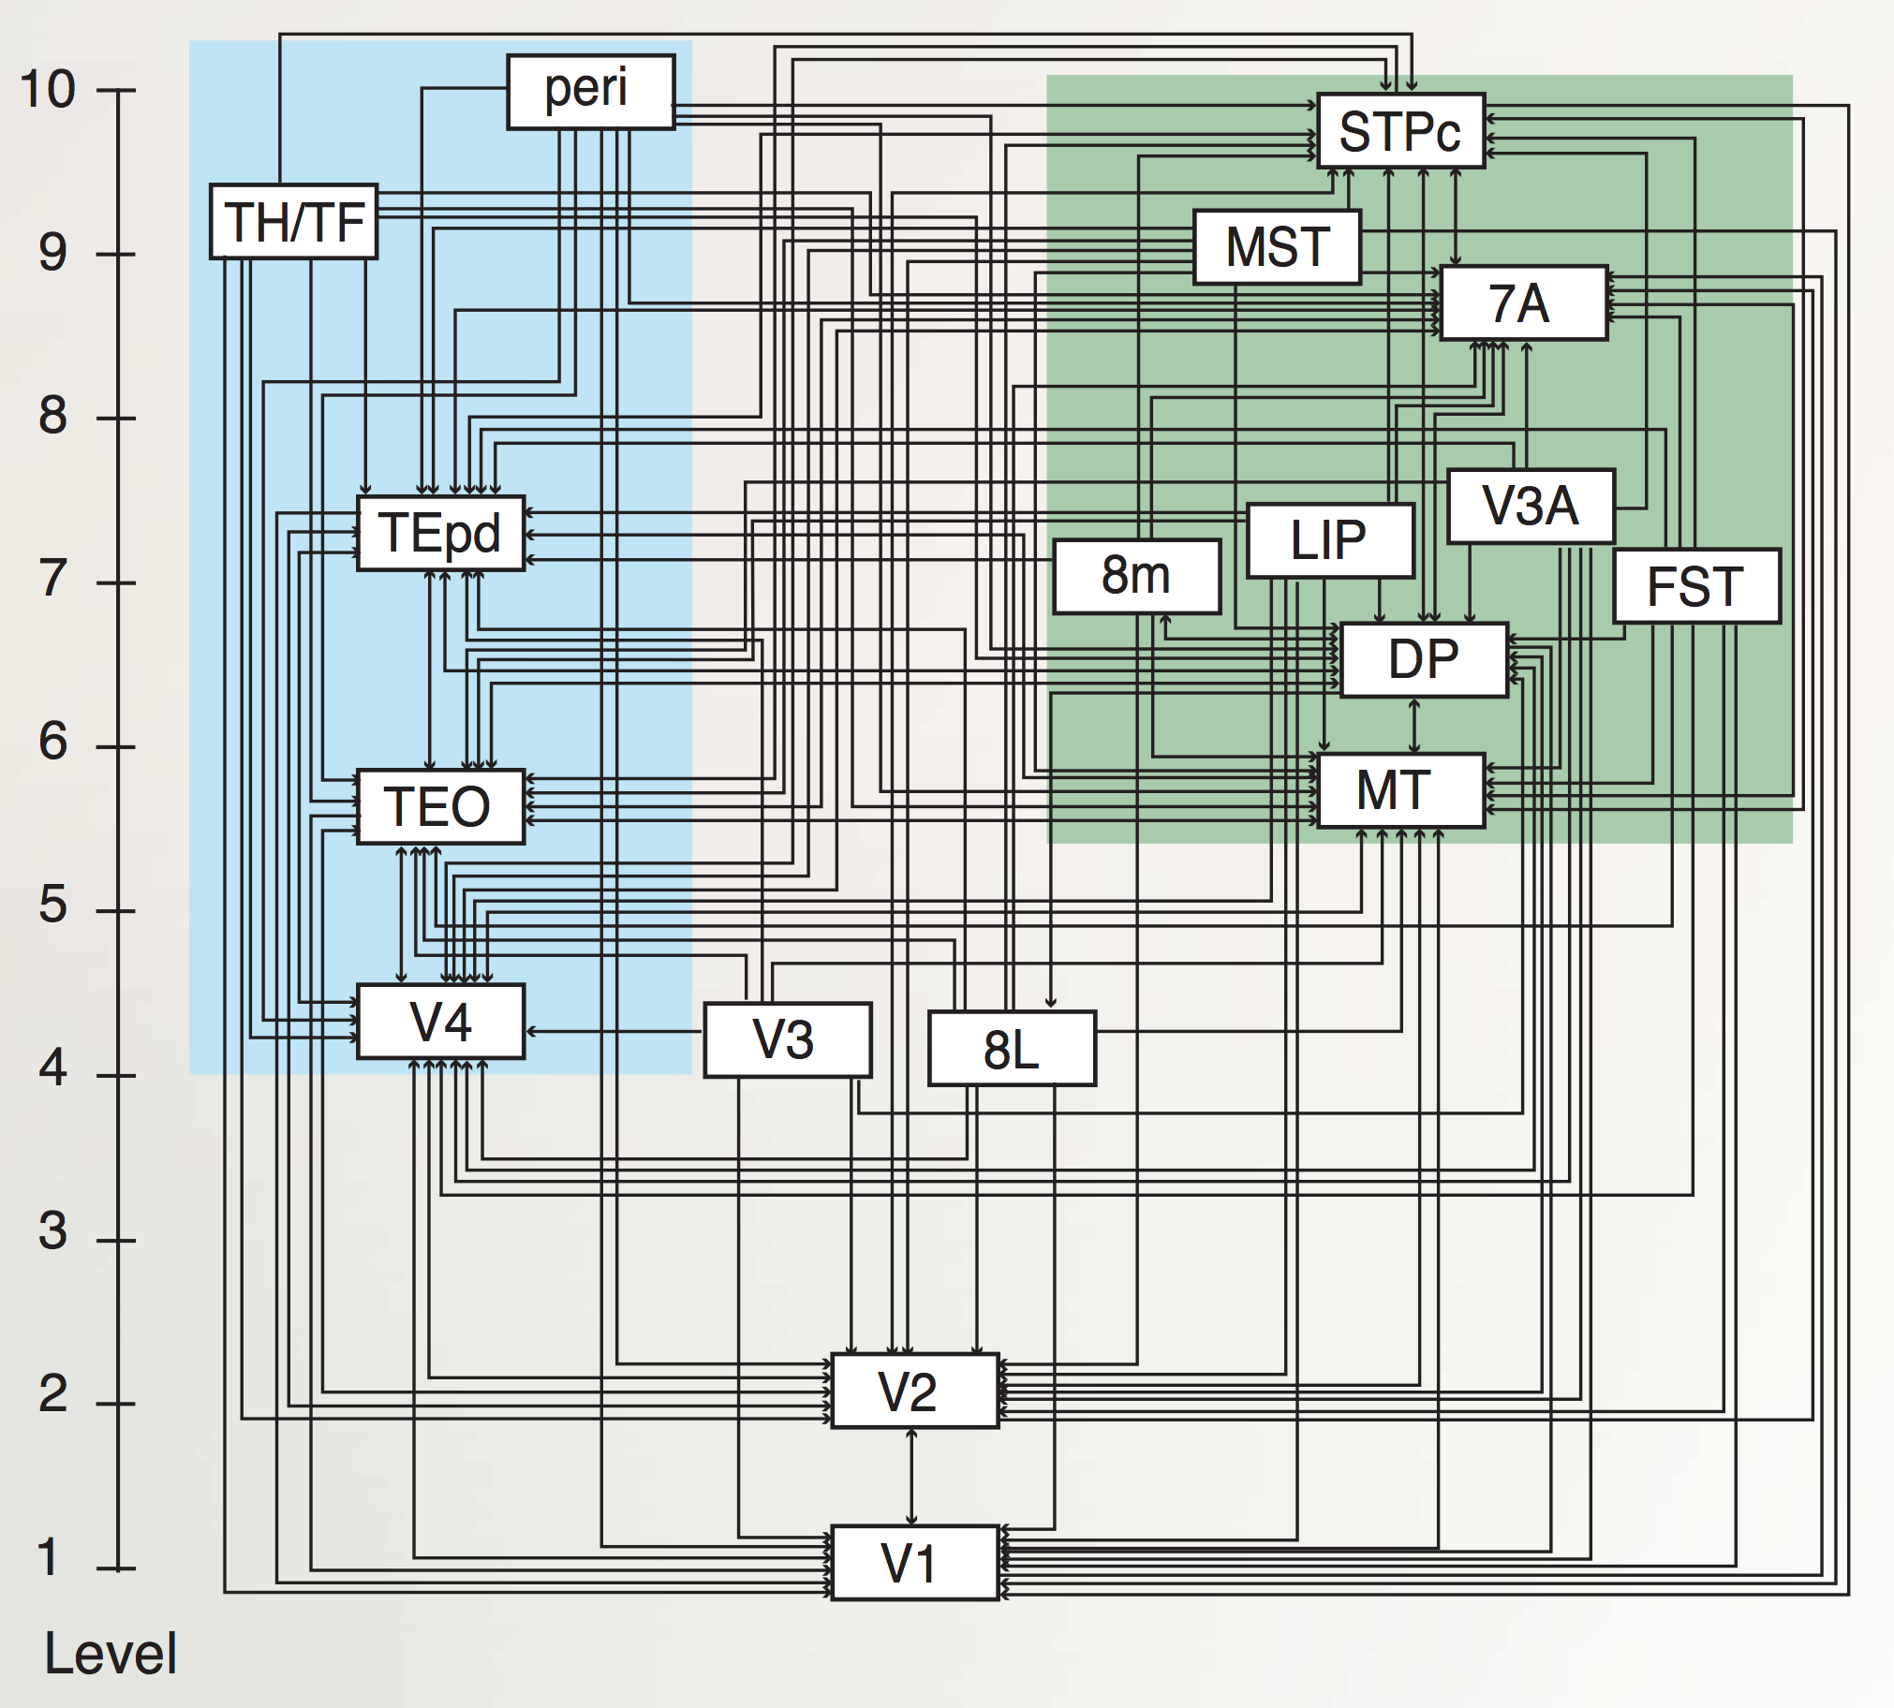
“Van Essen” Hierarchy
TE.. = Temporal
LIP, DP.. = Parietal
8L = Frontal Eye Field
To hippocampus:
TH/F = Parahippo
peri = Perirhinal
Markov et al., 2014

Slide 25
Hierarchy of Detectors (CCC = Compression: abstract, simplify)
Inferior Temporal (IT) cortex has high-level abstractions that are relevant to your life!
It takes a village of neurons to build up these abstractions.

Slide 26
Cortical Organization Summary
Occipital Lobe: vision
Temporal Lobe: object & face recognition, audition, speech, language, semantics
Parietal Lobe: space, number, action, somatosensory
Frontal Lobe: (motor) Control (executive), emotion, motivation
Left / right: not too popular in science now..

Slide 27
Rest of Brain
Hippocampus (archicortex – old cortex): episodic memories (events, facts, this lecture..)
Amygdala: emotions (reward, fear, etc): major controller of dopamine
Basal Ganglia: motor / cognitive initiation based on what has worked in the past (dopamine)
Thalamus: mini-me to cortex, interacts with BG
Cerebellum: tunes up fine motor control

Slide 28
Learning Rules Across the Brain
Area | Reward | Error | Self Org
Primitive Basal Ganglia | +++ | - - - | - - -
Cerebellum | - - - | +++ | - - -
Advanced Hippocampus | + | + | +++
Neocortex | ++ | +++ | ++
Learning Signal
+ = has to some extent … +++ = defining characteristic – definitely has
- = not likely to have … - - - = definitely does not have

Slide 29
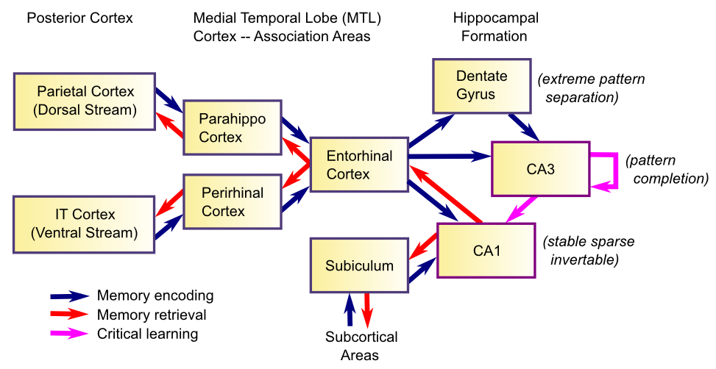
Memory and the Hippocampus
Memory is based on highly Compressed (CCC) summary of cortex – we don’t remember actual details very well!

Slide 30
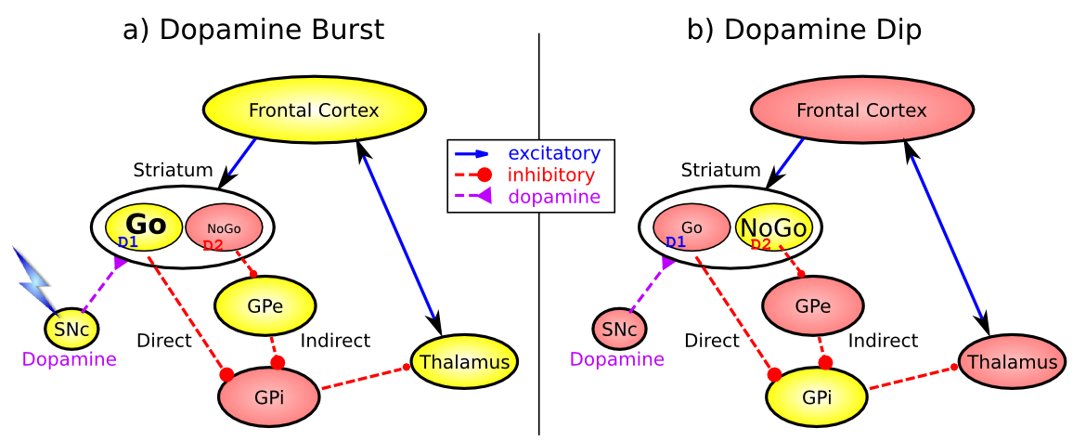
Basal Ganglia: Motor Initiation
Dopamine shapes selection of most rewarding (least punishing) action plan

Slide 31
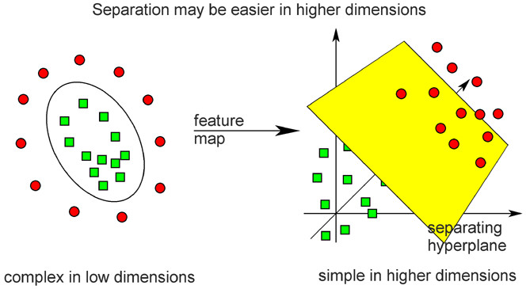
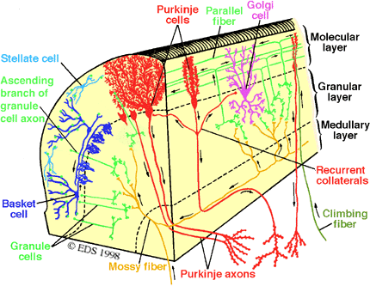
Cerebellar Error-driven Learning
Cerebellum =
Support Vector Machine
Granule cells = high-dimensional encoding (separation)
Purkinje/Olive = delta-rule error-driven learning
Classic ideas from Marr (1969) & Albus (1971)
Notes:
Time delayed weight changes
Can’t do backprop – need to have a generic all-purpose good-enough representation
First wave of computational modelers got the 1st principal component right on *everything*

Slide 32
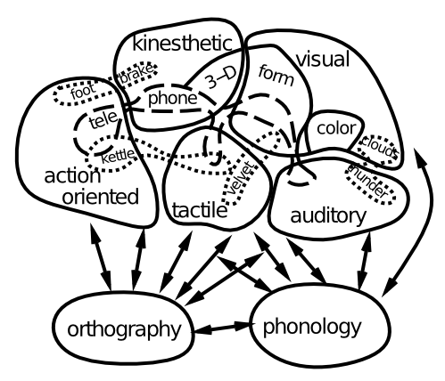
Language = Whole Brain!
Language and higher-level cognition builds on already-learned sensory / motor pathways

Slide 33

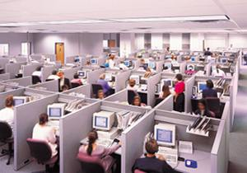
Frontal Executive: Top-Down Biasing CCC = Control!
PFC active maintenance provides top-down biasing of posterior-cortical processing

Slide 34
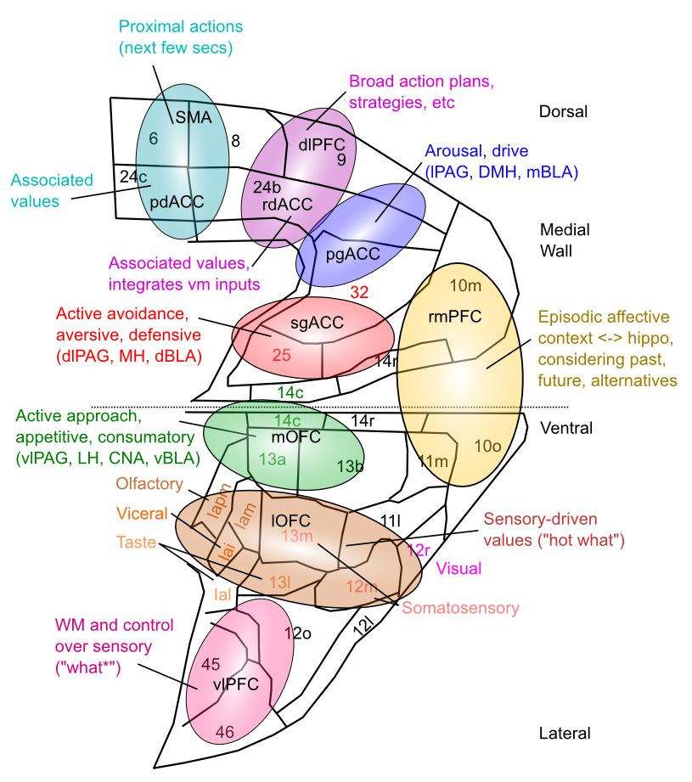
Medial Frontal Map of Values This is your emotional life

Slide 35
